Slide 1

Smart Water Leakage Detection
IoT-Based Monitoring for Smart Cities
Cyber Sentinels: Kalindu Ometh | Sajjana Maharu | Yasitha Buddhima | Lasith Madhusanka

Slide 2
Project Overview

Slide 3
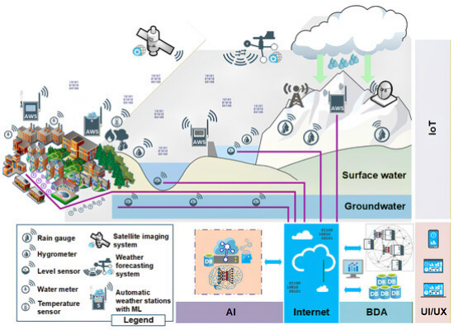
Catching Leaks on Day One
Right now, somewhere under a city street, water is leaking out of a pipe and nobody knows it.
By the time it's discovered, the city has lost thousands of liters and a chunk of its repair budget.
We are building a smart, connected system to catch these leaks within hours, not weeks.

Slide 4
Problem Statement

Slide 5

The Hidden Threat
Invisible Damage
Treated water is expensive, yet a massive portion never reaches the tap. Cracks open up in buried pipes, and water seeps into the soil unnoticed.
Thousands of liters vanish daily. Cities only react when residents complain about weak pressure or when the road above visibly collapses, multiplying repair costs exponentially.

Slide 6






Root Causes of Pipe Leaks
Aging Infrastructure
External Stress
Reactive Maintenance
Heavy vehicles rumbling overhead and nearby construction activities stress pipe joints never built for massive loads.
Pipes that are past their designed lifespan and heavy internal corrosion gradually eat away at structural integrity.
Utilities lack real-time visibility, relying on visual damage or pressure complaints rather than predictive data.

Slide 7
Proposed Solution

Slide 8


Proactive Data-Driven Defense
Continuous Monitoring
Smart Anomaly Detection
A network of low-power pressure, flow, and acoustic sensors placed at strategic junctions. They constantly watch the pipeline, ensuring there are no blind spots waiting to become an infrastructure crisis.
A lightweight cloud analytics layer compares incoming live readings against expected baselines. It flags abnormal flow patterns or pressure drops instantly, estimating the exact location for field crews.

Slide 9
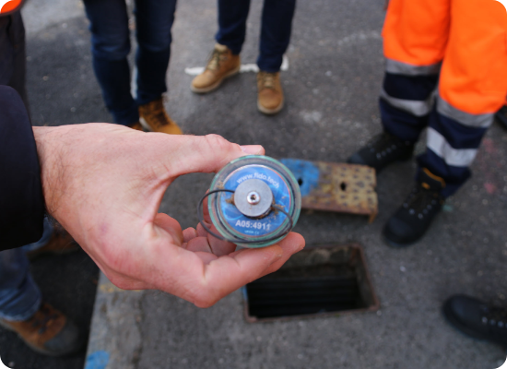
Target Users & Market Need
Municipal Water Authorities: Operators managing networks and paying the price for non-revenue water.
Infrastructure Teams: Public works departments dealing with road damage caused by leaks.
Maintenance Crews: Field teams who benefit from precise localization to reduce blind digging.
Market Need: Utilities demand a retrofit-friendly monitoring layer to avoid replacing the entire pipe network.

Slide 10
Methodology

Slide 11
System Architecture
Layered IoT Stack
Sensing: Pressure and flow nodes capture physical signals from pipeline segments.
Connectivity: LoRaWAN / NB-IoT transmits data over long distances with minimal power draw.
Analytics: A cloud engine checks real-time data against historical baselines to flag leaks instantly.

Slide 12
Detection Workflow
4. Alert
2. Transmit
An immediate alert with estimated location is pushed to the operator's web and mobile dashboard.
Readings are sent over a low-power wide-area network to the centralized cloud platform.
1. Monitor
3. Analyze
Sensor nodes measure pressure, flow, and acoustics along the pipe, nonstop.
The analytics engine cross-references live data against baseline thresholds to spot anomalies.

Slide 13
Conclusion

Slide 14
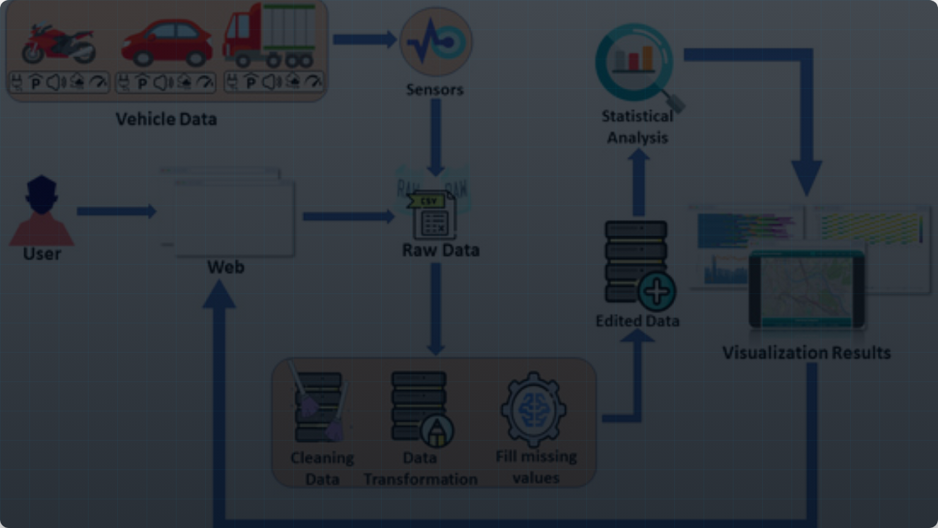

Visibility for the Invisible
By bringing continuous, connected monitoring to legacy infrastructure, we empower cities to catch underground leaks in hours instead of weeks—saving millions of liters of water, preserving public budgets, and building a more sustainable future.

